Slide 1
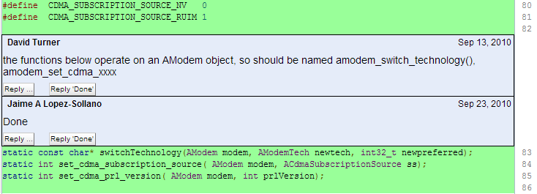
Code Review Example: 1
Style Inconsistency!
Notes:
In the first example, the author has used camelCases in indentifier naming, where other lines have used underscores. This is a style inconsistency issue identified by the reviewer.

Slide 2
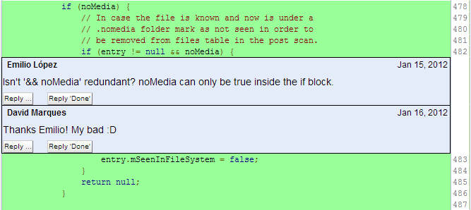
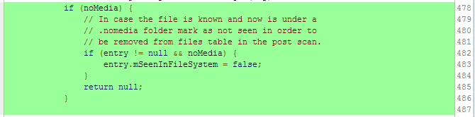
Code Review Example: 2
Silly mistake!
Notes:
Author created a silly mistake of including a redundant check. Many times developers commit this type silly mistakes. In this case, it was not a bug, but sometimes it can cause defects.

Slide 3
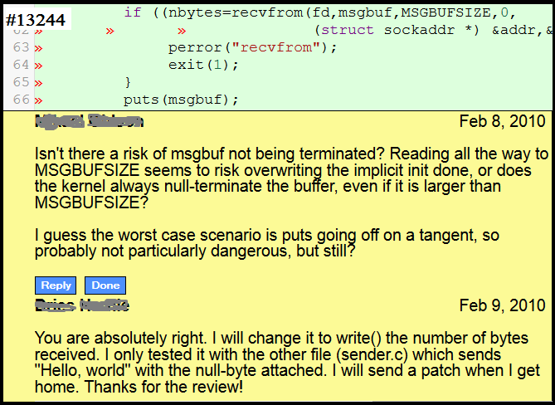
Code Review example: 3
Buffer Overflow!

Slide 4
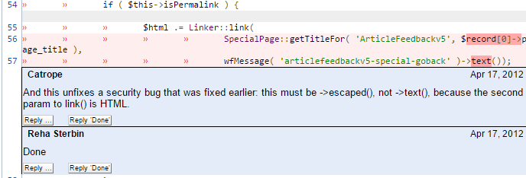
Code Review Example: 4
XSS Vulnerability!
Notes:
In this example, the author has used a unsafe html handling method. This has the potential to open cross site scripting attack. The reviewer identifies that and the author fixes it.

Slide 5
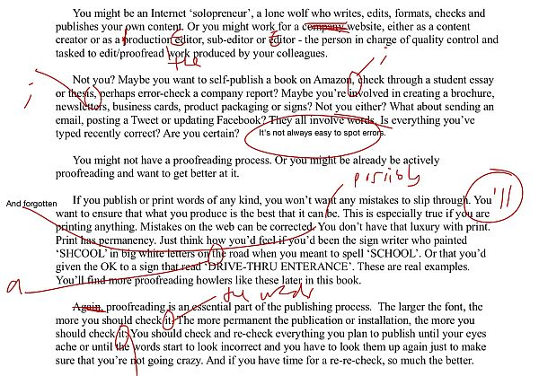
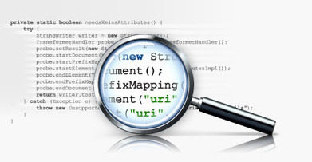


Proofreading
“The process of analyzing code written by a teammate (i.e. a peer) to judge whether it is of sufficient quality to be integrated into the main project codebase.”
Notes:
For example, book publishers face similar problem in correcting text. For years, they have employed proofreaders, who can examine the text with a fresh pair of eyes. You may also have the experience of someone else read your writing and returning you something like this.
Software development has a similar practice as proofreading, which we call peer code review. Peer code review is the process of analyzing code written by a teammate to judge whether it is of sufficient quality to be integrated into the main project codebase. Today, I will talk about contemporary peer code reviews.

Slide 6



Code Review Workflow
Author
Writes
Code
Edits
Code
Abandon
Review
Request
No
…
Accepted?
Accept
Merge
Reviewer
Yes
Reviews
Code
Reviews
Code
Approval
Notes:
Let’s look into a typical code review workflow. Code review process starts after an author writes a code and submits the code for review by creating a review request. A reviewer accepts the review request. He reviews the code and provides feedback. The author modifies the code to address the review comments and submits the code again for review. This process of author modifying code and reviewer providing suggestions repeats until the reviewer approves the code or the author abandons the change. If the code is approved the author can integrate the code into main project code base.

Slide 7
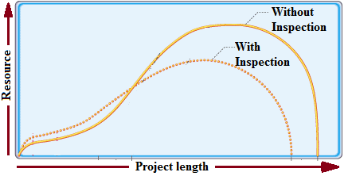
History
Code Inspection
  A.k.a. Fagan Inspection
  Improves software quality
Fagan’s “snail curve” (Advances in Software Inspection, Fagan 2001), image (adapted color version) taken from (http://www.embedded.com/design/prototyping-and-development/4023337/Verification-and-Validation)
Notes:
The concept of peer code review is not entirely new. The formal variant of peer code review, which is known as software inspection or Fagan inspection has been under practice for nearly four decades. Studies have shown that code inspection improves the quality of software.
For example, the snail curve from Fagan’s paper shows that code inspecting reduces amount of effort as well as project length.
However, code inspection is process heavy and requires synchronous meeting. Due to those constraints, code inspection was not feasible for many organizations.
Therefore, code inspection had relatively low adoption.
The concept of peer code review is similar, however there are differences in execution.
Compared with Fagan inspection, peer code review is informal, lightweight, does not require synchronous meeting.
Code review has been well adopted among software organizations.

Slide 8
Software Inspection
Planning
Overview
Follow Up
Preparation
Rework
Meeting
Problems
  Process heavy
  Arranging meetings difficult
  High cost
  Low adoption
Notes:
Planning
Preparation of materials
Arranging of participants
Arranging of meeting place
Overview
Group education of participants on the materials under review
Assignment of roles
Preparation
The participants review the item to be inspected and supporting material to prepare for the meeting noting any questions or possible defects
The participants prepare their roles
Inspection meeting
Actual finding of defect
Rework
Rework is the step in software inspection in which the defects found during the inspection meeting are resolved by the author, designer or programmer. On the basis of the list of defects the low-level document is corrected until the requirements in the high-level document are met.
Follow-up
In the follow-up phase of software inspections all defects found in the inspection meeting should be corrected

Slide 9


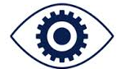

Code Review Tools
Gerrit: https://code.google.com/p/gerrit/
Review Board: https://www.reviewboard.org/
Phabricator: https://phabricator.org/
Crucible:
https://www.atlassian.com/software/crucible
Notes:
Contemporary code reviews are tool-based. Popular code review tools include: Gerrit, ReviewBoard, Phabricator, and Crucible.

Slide 10
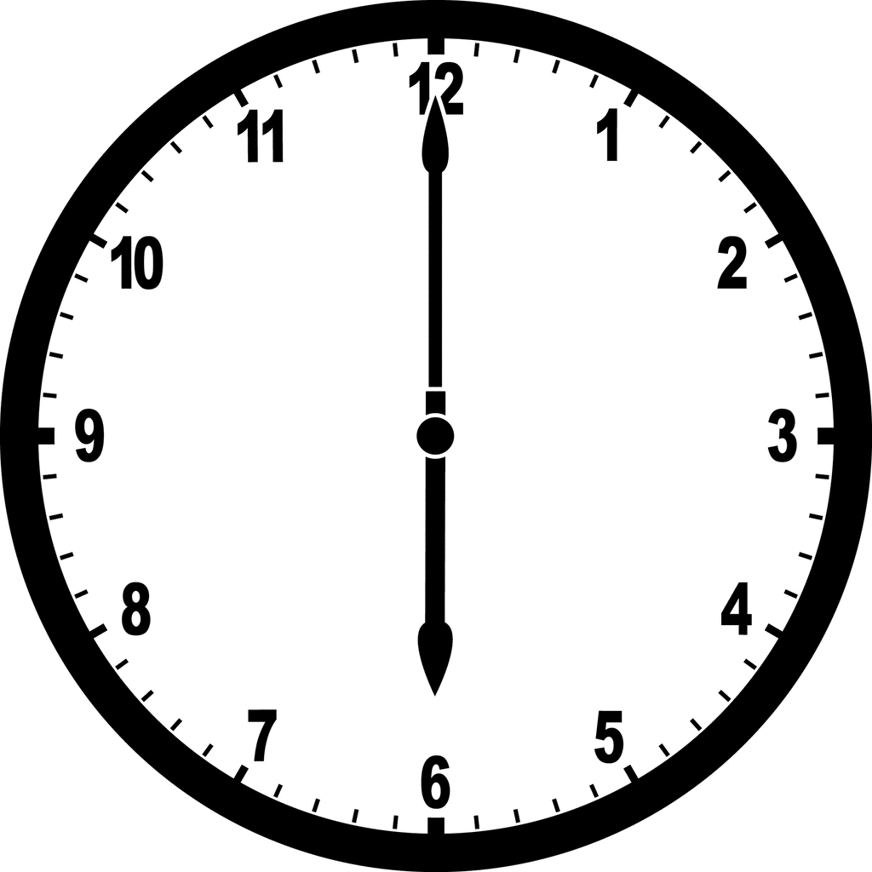

Code Review Efforts
Avg. 6 hours / week
10%~15% of developer times
: 50,000 developers
X 6 hours/ week X $50 /hour
= $15,000,000 / Week
Notes:
For example, in one of our study we found that developers spend around 6 hours per week in code reviews. This translates to almost 10 to 15% developer times.
Almost, 50,000 Microsoft developers are practicing code reviews.
Let’s do a calculation. 50,000 developers multiplied by 6 hours per week multiplied by a conservative amount of 50 dollars per hour
= 15 million dollars per week. Therefore, improving effectiveness of code reviews can ensure that those efforts are spent wisely.

Slide 11




Simplified code review workflow
Main project
branch
Code review repository
Pull to local branch
Push to main
Reviews
Code
Notifies
Yes
Developer’s
Local
Branch
Push to Gerrit/github
Approved
Reviewer
Notifies developer
No
Developer

Slide 12
Issues identified during code reviews
Redundant checks
Project design violation
Coding style
Misunderstood requirements
Critical security defects
Malicious code
Lack of exception handling
Inadequate input validation
Unsafe methods

Slide 13
Issues identified during code reviews
Redundant checks
Project design violation
Coding style
Misunderstood requirements
Critical security defects
Malicious code
Lack of exception handling
Inadequate input validation
Unsafe methods

Slide 14
Best practices for code reviews
Source: https://smartbear.com/learn/code-review/best-practices-for-peer-code-review/

Slide 15
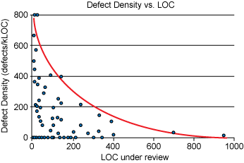
1. Review fewer than 200–400 lines of code at a time
Source: https://smartbear.com/learn/code-review/best-practices-for-peer-code-review/

Slide 16
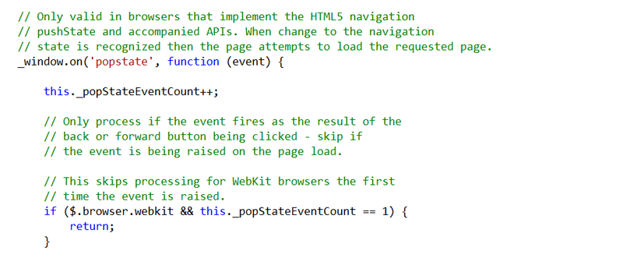
Be sure that authors annotate source code before the review begins.
Annotations guide the reviewer through the changes
Showing which files to look at first and defending the reason behind each code modification.
Annotations should be directed at other reviewers to ease the process and provide more depth in context.
Source: https://smartbear.com/learn/code-review/best-practices-for-peer-code-review/

Slide 17

Establish quantifiable goals for code review and capture metrics so you can improve your processes.
Set a few tangible goals
  reduce support calls by 15%,
  cut the percentage of defects injected by development in half.
Collect process metrics
  Inspection rate: the speed with which a review is performed
  Defect rate: the number of bugs found per hour of review
  Defect density: the average number of bugs found per line of code
Source: https://smartbear.com/learn/code-review/best-practices-for-peer-code-review/

Slide 18
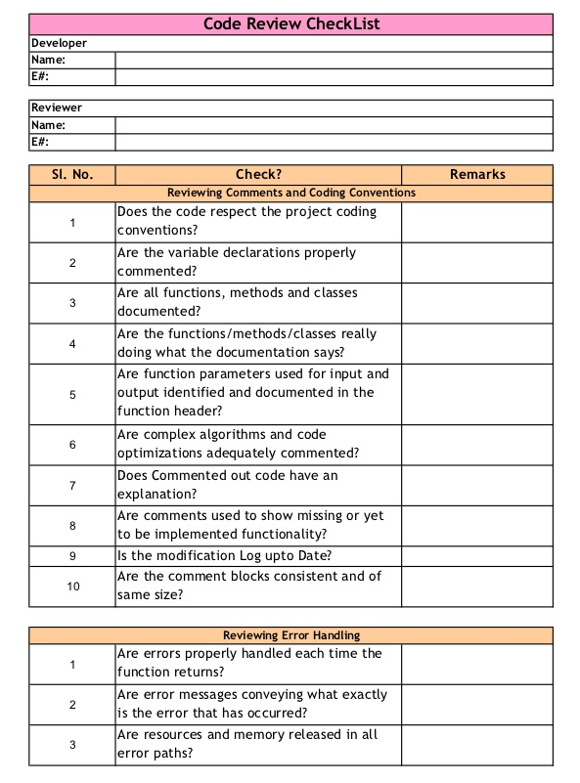
Use checklists, because they substantially improve results for both authors and reviewers.
Developers often make the same mistakes over and over
Omissions in particular are the hardest defects to find because it´s difficult to review something that isn´t there.
Checklists are the most effective way to eliminate frequently made errors and to combat the challenges of omission finding.
Source: https://smartbear.com/learn/code-review/best-practices-for-peer-code-review/

Slide 19
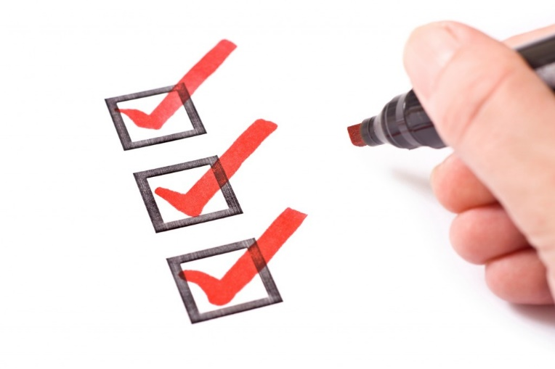
Verify that the defects are actually fixed.
How will the bugs be fixed?
Many teams do not have a systematic method for fixing the bugs they´ve worked so hard to find.
Reviewers should log bugs, discuss them with the author, and approve changes in the code.
Source: https://smartbear.com/learn/code-review/best-practices-for-peer-code-review/

Slide 20
Foster a good code review culture in which finding defects is viewed positively.
Peer review can put strain on interpersonal team relationships.
It´s difficult to have every piece of work critiqued by peers and to have management evaluating and measuring defect density in your code.
It´s extremely important that mangers create a culture of collaboration and learning in peer review.
While it´s easy to see defects as purely negative, each bug is actually an opportunity for the team to improve code quality.
Defects found in peer review are not an acceptable rubric by which to evaluate team members.
Source: https://smartbear.com/learn/code-review/best-practices-for-peer-code-review/

Slide 21
Other benefits of Code review
Project awareness
Peer impression formation
Consistent coding style
Design discussion
Knowledge dissemination

